Slide 1


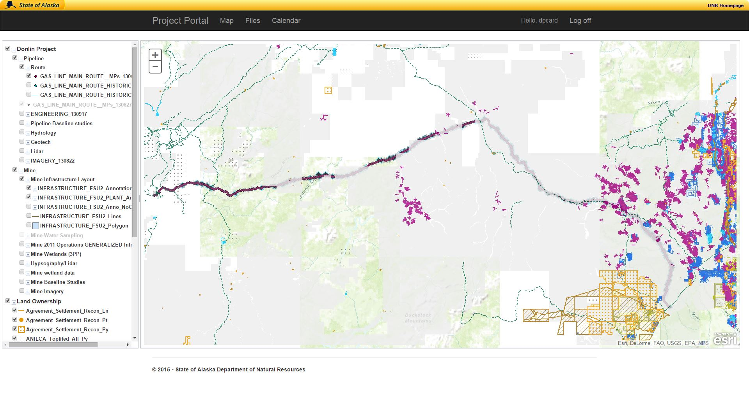

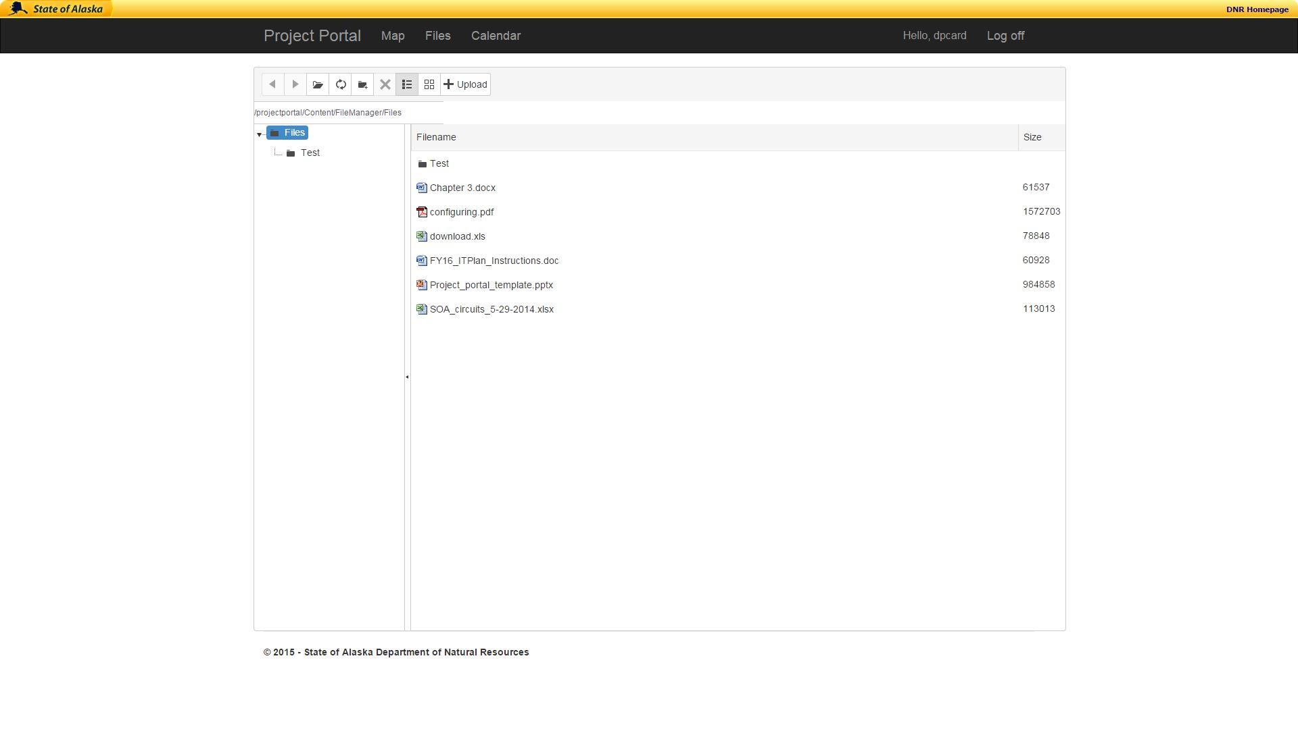
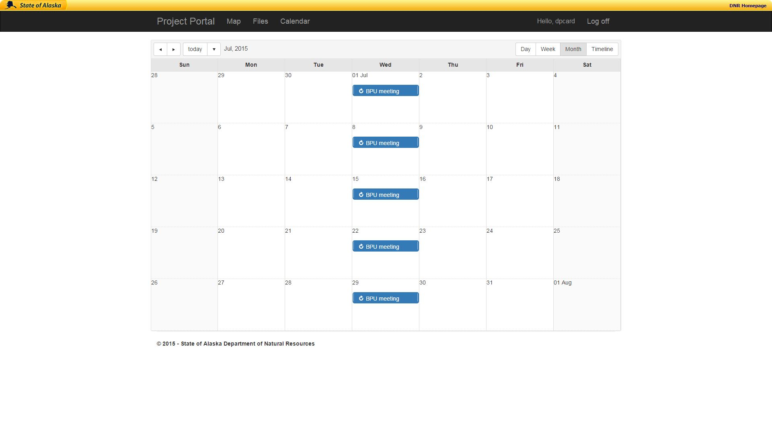
Project Portal
REPLACE THIS BOX WITH YOUR ORGANIZATION’S
HIGH RESOLUTION LOGO
Daniel Card
Supervisor: Prof. Kenrick Mock, PhD
University of Alaska Anchorage, College of Engineering
Abstract
Hardware & Software
Project Portal is a web application that is designed to facilitate simple and effective project collaboration and communication. This paper will discuss the details of the implementation and the process whereby Project Portal was created. The main components of Project Portal are a landing page, a map, a calendar, and a file browser. All of the development for Project Portal was done using Microsoft’s .Net web platform.
Project Portal is running on a server machine that has Windows Server 2012 R2. It interfaces with a Microsoft Exchange server that controls the calendar page. Security is handled by a server that uses the lightweight directory access protocol (LDAP) to provide user credentials.
The calendar and file browser use an application programming interface (API) from Telerik to provide the framework for the visual display of each web page. The API allows for customization and simple access to a number of configurations that create a nicer user interface.
An API from ESRI was used to make the base map. DNR has created web services that contain the project specific layer information that can be displayed on the base map.
Figure 1. Image of Map Page
Introduction
Design
This capstone project began as wish list item at the State of Alaska Department of Natural Resources (DNR). They needed a small web application that could facilitate simple and more efficient collaboration within project teams. One of the design plans behind Project Portal was that it would be a template application. This would make it easy to replicate and customize for a number of different existing or new projects within DNR. Having access to a map that contains project specific information is imperative because DNR is tasked with controlling the land and water within Alaska. A calendar was necessary to allow for a specific calendar with only project events and meetings on a single calendar. Another item that became important for project collaboration was to be able to share files and documents between team members. The three main tools needed to be accessible from anywhere, therefore a web application became the design of choice.
The design of Project Portal was primarily based upon its requirements. Microsoft ASP.NET was chosen as the web platform to use when creating Project Portal. ASP.NET uses ASP and html for the code that is sent to the web browser while C# is used for the back-end program code. Design and programming for Project Portal was careful to retain the ability to use any of the modern browsers for access (i.e. Google Chrome, Microsoft Internet Explorer, and Mozilla Firefox). This allows the user to simply navigate the web browser of their choice to the web address for the information they need. The design of Project Portal also lends itself nicely to future expansion. Future development might include the addition of a project manager’s blog or a notebook where team members could quickly share ideas.
Figure 2. Image of File Browser Page
User Interface
The user interface for Project Portal was purposefully designed to be simple, efficient, and easy to use. Web page elements were placed in the typical locations in order to increase the web pages intuitiveness.
To make logging in effortless for the users, LDAP credentials are used. Almost all the users of Project Portal will be very familiar with using their LDAP credentials to access web resources.
The Twitter bootstrap was used to give a modern look and feel to the user interface. Bootstrap is essentially just Cascading Style Sheet (CSS) templates that tell the web browser how to display each element. Using these templates has become immensely popular in current web site design.
A JavaScript library called JQuery was used to implement some of the features that required dynamic programming.
Conclusion
Project Portal will be a great asset to project teams at DNR giving them the ability to quickly and simply share project related information. The design of Project Portal was created in such a way to make it useable repeatedly on a wide variety of projects and could be customized to fit the needs of each individual project. Project Portal and programs similar to it will become increasingly important as efficient team communication and collaboration have become essential in the today’s business world.
Figure 3. Image of Calendar Page
Contact
Daniel Card
University of Alaska Anchorage
Email: dcard2@alaska.edu

